Slide 1
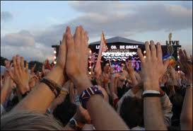
Discovering our Rhythm James1:22-25

Slide 2
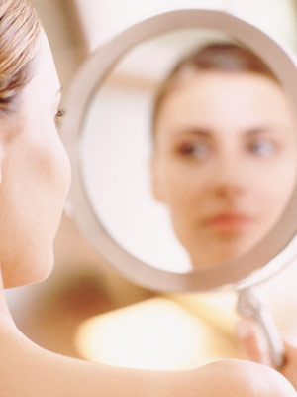
The Rhythm Begins by Listening
“But don’t just listen to God’s word. You must do what it says. Otherwise, you are only fooling yourselves. 23 For if you listen to the word and don’t obey, it is like glancing at your face in a mirror. 24 You see yourself, walk away, and forget what you look like. James 1:22-24

Slide 3
Discovering Our Rhythm
But if you look carefully into the perfect law that sets you free, and if you do what it says and don’t forget what you heard, then God will bless you for doing it.” James 1:25

Slide 4
Observing the Rhythm
But if you look carefully into the perfect law that sets you free, and if you do what it says and don’t forget what you heard, then God will bless you for doing it."

Slide 5
Observing the Rhythm Looking carefully does two things.
First, it changes our appearance or character.

Slide 6
Observing the Rhythm
But if you look carefully into the perfect law that sets you free, and if you do what it says and don’t forget what you heard, then God will bless you for doing it."

Slide 7
Observing the Rhythm Looking carefully does two things.
First, it changes our appearance or character.
Secondly, we begin to hear the rhythm of freedom.

Slide 8
Observing the Rhythm
But if you look carefully into the perfect law that sets you free, and if you do what it says and don’t forget what you heard, then God will bless you for doing it."

Slide 9
Discovering our Rhythm by Doing
But if you look carefully into the perfect law that sets you free, and if you do what it says and don’t forget what you heard, then God will bless you for doing it."

Slide 10
Discovering our Rhythm by Doing
But if you look carefully into the perfect law that sets you free, and if you do what it says and don’t forget what you heard, then God will bless you for doing it."

Slide 11
Following the Leader of Our Rhythm
But if you look carefully into the perfect law that sets you free, and if you do what it says and don’t forget what you heard, then God will bless you for doing it."

Slide 12
Three Ways to Begin to Discover our Rhythm
Ask the Holy Spirit for insights as to how to do it
Ask someone for advice as to how they understand and practice what they have learned.
Think of three practical ways you can be a “doer” of the word.

Slide 13
Discovering our Rhythm
Am I listening to the rhythm?
Am I observing the rhythm? ?
Am I practicing the rhythm?
Am I following the rhythm of the Leader (Jesus)

Slide 14
Discovering our Rhythm James1:22-25

