Slide 1
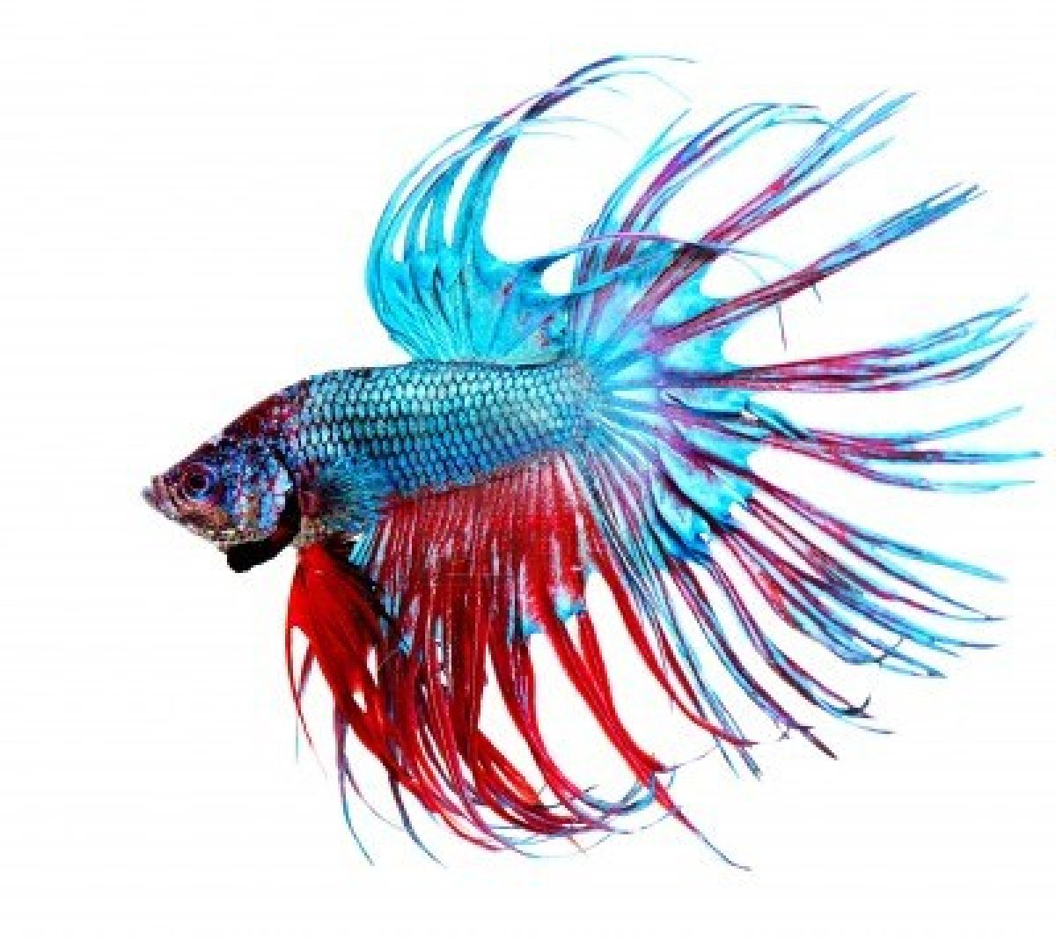
Romans 7:14-25
Fight to Follow

Slide 2
Romans 7:14-25
So the trouble is not with the law, for it is spiritual and good. The trouble is with me, for I am all too human, a slave to sin. I don’t really understand myself, for I want to do what is right, but I don’t do it. Instead, I do what I hate. But if I know that what I am doing is wrong, this shows that I agree that the law is good. So I am not the one doing wrong; it is sin living in me that does it.
And I know that nothing good lives in me, that is, in my sinful nature. I want to do what is right, but I can’t. I want to do what is good, but I don’t. I don’t want to do what is wrong, but I do it anyway. But if I do what I don’t want to do, I am not really the one doing wrong; it is sin living in me that does it.

Slide 3
Romans 7:14-25
I have discovered this principle of life—that when I want to do what is right, I inevitably do what is wrong. I love God’s law with all my heart. But there is another power within me that is at war with my mind. This power makes me a slave to the sin that is still within me. Oh, what a miserable person I am! Who will free me from this life that is dominated by sin and death? Thank God! The answer is in Jesus Christ our Lord. So you see how it is: In my mind I really want to obey God’s law, but because of my sinful nature I am a slave to sin.

Slide 4
The trouble is with me (the fight is against sin)

Slide 5
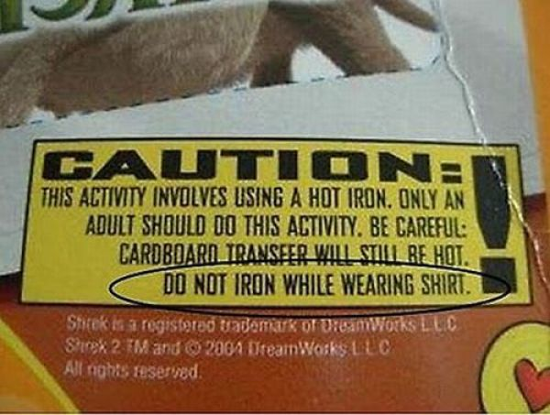

Slide 7
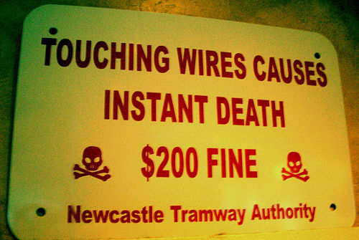

Slide 8
Samurai Fighting Fish

Slide 9
The answer is in Jesus Christ our Lord (the fight is a process of sanctification)

Slide 10
In the battle remember...
Grace over guilt
Hope over despair
Love over all

